Slide 1

SCALES AND RELIABILITY ANALYSIS PRESENTATION
By Misheck Malangano

Slide 2
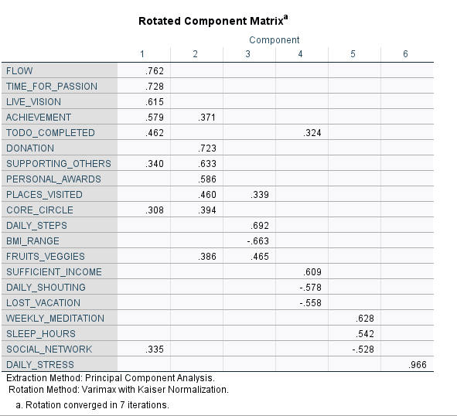
Constructs From Factor Analysis
Life Goals Factor
Social Responsibility Factor
Stress Factor
Relationship Factor
Physical Health Factor
Relaxation Factor

Slide 3
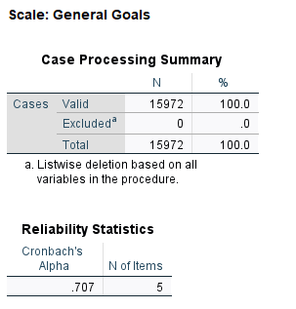
Scale 1: General Goals
Sample Size- 15972
Cronbach’s Alpha measures how variables are correlated.
Our Cronbach’s Alpha is 0.707
A value of 0.7 or greater is Good
Number of Items is 5

Slide 4
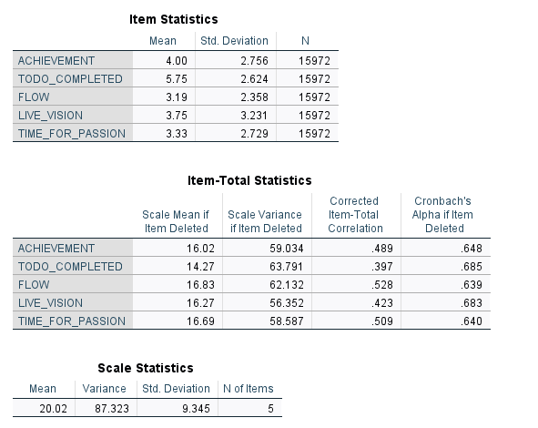
Item Statistics
If we delete One Item from the variables Cronbach’s Alpha would Decrease

Slide 5
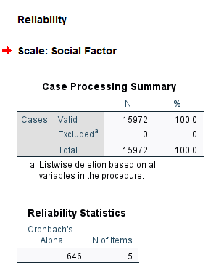
Scale 2 Social Factor
Cronbach’s Alpha is 0.646
5 Variables used.

Slide 6
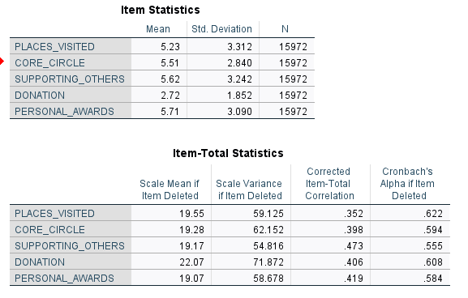
ITEM STATISTICS
We need to add more variables to increase Cronbach’s Alpha.

Slide 7
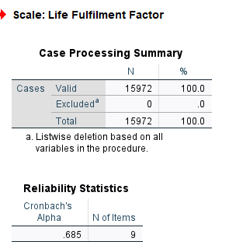
Modified Scale
Four more Variables were added.
Cronbach’s Alpha Has Increased from 0.646 to 0.685
Highest Cronbach’s Alpha we could get.

Slide 8
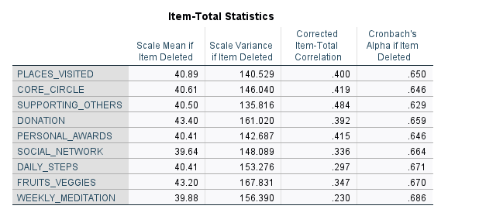
New Variables Added

Slide 9
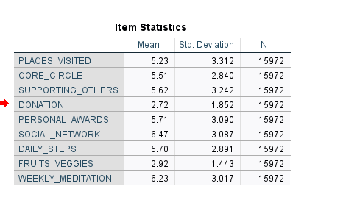
ITEM STATISTICS

Slide 10

NEW CONSTRUCTS
Life Goals
Fulfillment

Slide 11
NEW CONSTRUCTS
1.LIFE GOALS
2.FULFILMENT
Flow
Time For Passion
Live Vision
Achievement
To do Completed
Places Visited
Core Circle
Supporting Others
Donation
Social Network
Daily Steps
Fruits and Veggies
Weekly meditation

Slide 12
THANK YOU

